Slide 1

Leaf Disease Detection Using Deep Learning Techniques
TEAM NO : 12
1. 20R21A1229- K. NAVEEN
2. 20R21A1232- K. HARSHA VARDHAN
3. 20R21A1225- J. PREM CHANDRA
4. 20R21A1241- P. NANDU
GUIDE NAME :- Mrs. JEETHU PHILIP (Assistant professor)

Slide 2
Abstract
Agriculture is the mainstay of the Indian economy. Immense commercialization of an agriculture has creates a very negative effect on our environment. In agricultural field the disease in plants is more common and the detection of disease in plants has become more feasible.
we proposed a deep-learning-based approach to detect leaf diseases in many different plants using images of plant leaves
In agricultural field,the disease in plants is more common and the detection of disease in plants has become more feasible.
Plant leaf diseases and destructive insects are a major challenge in the agriculture sector. Faster and an accurate prediction of leaf diseases in crops could help to develop an early treatment technique while considerably reducing economic losses.
Our goal is to find and develop the more suitable deep-learning methodologies for our task.

Slide 3
INTRODUCTION
In agricultural field, the disease in plants is more common and the detection of disease in plants has become more feasible due to the above reason.
In the premature phase we can detect the symptoms of the plant diseases since their first appearance on their leaves of the plants.
The objective of this the user may easily utilise this method to determine if a leaf is infected or not at any moment.
Although there are various methods for diagnosing illnesses, most are slow and have limitations

Slide 4
EXISTING SYSTEM:
The existing method for plant disease detection is simply our naked eye observation by experts through which identification and detection of plant diseases is done.
We use CNN and DNN neural networks.
Classification by CNN is divided into phases which tackle separate tasks.
Pre-processing
Feature Extraction
Non-Linear Mapping
Reconstruction

Slide 5
DRAWBACKS OF EXISTING SYSTEM:
Only humans are capable of predicting diseases.
The procedure is extremely slow.
Consumption of time and space is also very high.
The price is also high.
The proposed methods cannot detect multiple diseases in one image or cannot detect multiple occurrences of the same diseases in one image.

Slide 6
Proposed System:
This project is done using Deep Learning Techniques.
Deep learning is a learning system based on neural networks.
Benefits of deep learning is that it can automatically extract features from photos.
By Deep Learning, we get the results by CNN algorithm.
CNN(Convolution Neural Network) is an efficient recognition algorithm which is widely used in pattern recognition and image processing.
DNN(Deep Neural Network) solves the classification problem by connecting as many points as possible.

Slide 7
ADVANTAGES:
Detects related images with a low-cost camera and open cv
Open cv adds in the efficient analysis of images.
Before this we use to take the help of agriculture professor but now we can find its disease by taking photos of the leaf.
We can save plants at the initial stage. So it reduces the time and money.

Slide 8
Software Requirements
SOFTWARE AND HARDWARE REQUIREMENTS:
Hardware
Requirements
Operating system : Windows 10 Modules : Numpy,CV2,Tkinter Input images and videos of leaf Dataset : Plant village dataset Algorithm : Faster R-CNN
RAM - 8GB (min)
Hard Disk – 128 GB Processor -I5/Intel processor

Slide 9

SYSTEM ARCITECTURE
Although the convolutional-neural-network-based deep-learning architecture achieved high success rates in the detection of plant diseases, it has some limitations, and there is a scope for future works. A little noise in the sample images led to misclassification by the deep-learning model.
An architectural diagram outlines the system’s components, their relationships, and system functionality. A huge dataset where the data is pre-processed, then it is classified using RCNN algorithm and finally the model is trained. Users input the leaf image into the dataset, which evaluates the leaf based on its features and determines whether the leaf is infected or not. The final output is then sent to the user.
Faster
CNN
RCNN
RCNN

Slide 10
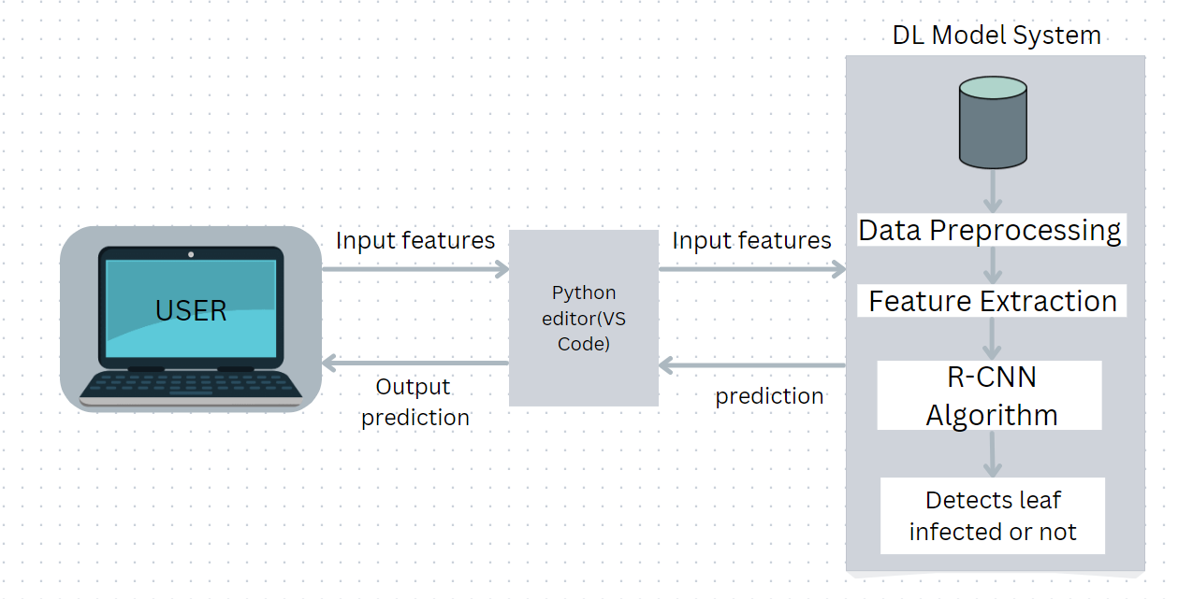
Figure System Architecture

Slide 11
Data Flow Diagram:
The data flow diagram (DFD) is one of the most important modeling tools. It is used to model the system components. These components are the system process, the data used by the process, an external entity that interacts with the system and the information flows in the system.
DFD shows how the information moves through the system and how it is modified by a series of transformations. It is a graphical technique that depicts information flow and the transformations that are applied as data moves from input to output.

Slide 12
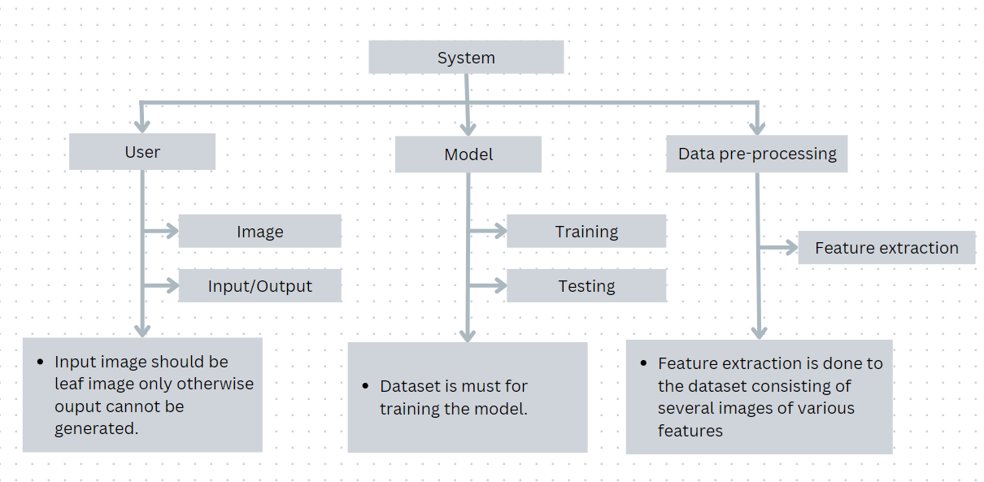
Figure Data Flow Diagram

Slide 13
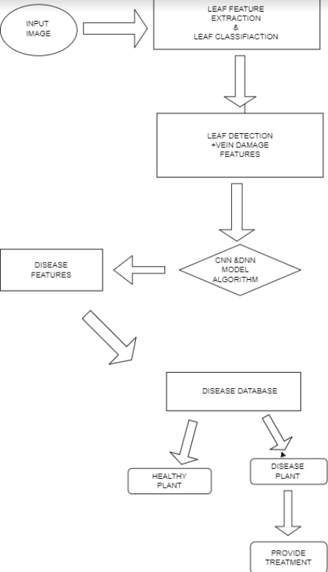
UML DIAGRAMS:
CLASS DIAGRAM:

Slide 14
IMPLEMENTATION
MODULES:
List of modules:
• Image acquisition.
• Image pre-processing.
• Image enhancement.
• Image segmentation.
• Image analysis.
• Feature extraction.
• Disease classification.

Slide 15
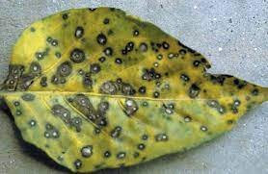
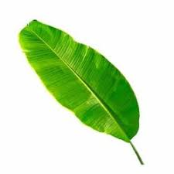
RESULTS:
Figure 1
Figure 2
Output:-
heightLB = 400
light brown LBmax_x = 316
light brown LBmax_y = 235
yellow to light brown Ymax_x = 16
yellow to light brown Ymax_y = 21
brown to black Bmax_x = 8
brown to black Bmax_y = 12
only yellow TYmax_x = 16
only yellow TYmax_y = 21
only brown TBmax_x = 8
only brown TBmax_y = 10
Yellow = 21
Brown = 10
Output:-
heightLB = 400
light brown LBmax_x = 10
light brown LBmax_y = 21
yellow to light brown Ymax_x = 0
yellow to light brown Ymax_y = 0
brown to black Bmax_x = 0
brown to black Bmax_y = 0
only yellow TYmax_x = 0
only yellow TYmax_y = 0
only brown TBmax_x = 0
only brown TBmax_y = 0
Yellow = 0
Brown = 0

Slide 16
CONCLUSION:
Disease detection and identification is done by using an image processing.
This helps by using eye observations, a farmer observes symptoms of disease in plants that need continuous monitoring. This help them in this problem to make it easy using these deep learning technique
Plant diseases have long been a major issue in agriculture. Making the best judgments possible based on the outcomes of DL techniques has made precision agriculture possible, enabling early disease identification and the minimizing of losses.
Recent developments in DL offer solutions with extremely precise findings, and the technology that is now accessible permits quick processing. The decision-making procedure, nevertheless, may be enhanced. The models that are now available perform poorly when evaluated under actual circumstances.

Slide 17
REFERENCES:
Jiang, Peng, et al. "Real-time detection of apple leaf diseases using deep learning approach based on improved convolutional neural networks." IEEE Access 7 (2019): 59069-59080.
Wang, Qimei, et al. "Identification of Tomato Disease Types and Detection of Infected Areas Based on Deep Convolutional Neural Networks and Object Detection Techniques." Computational Intelligence and Neuroscience 2019 (2019).
Kumar, Akshay, and M. Vani. "Image Based Tomato Leaf Disease Detection." 2019 10th International Conference on Computing, Communication and Networking Technologies (ICCCNT). IEEE, 2019.
Ozguven, Mehmet Metin, and Kemal Adem. "Automatic detection and classification of leaf spot disease in sugar beet using deep learning algorithms." Physica A: Statistical Mechanics and its Applications 535 (2019): 122537.
Karthik, R., et al. "Attention embedded residual CNN for disease detection in tomato leaves." Applied Soft Computing 86 (2020): 105933.
Ashok, Surampalli, et al. "Tomato Leaf Disease Detection Using Deep Learning Techniques." 2020 5th International Conference on Communication and Electronics Systems (ICCES). IEEE, 2020.

Slide 18


